Slide 1



MID-SEM BTP PRESENTATION
25th September 2023
Personalized Recommendation with Realtime Clickstream
MENTOR : Dr. Anil Rajput
GROUP :
Priyansh, Harsh, Saikrishna Lingam, Santu Dhali, Rohan Kumar
CSE + ECE Department, IIIT Pune

Slide 2
Table Of Content
RS Concepts & Existing Solutions
Motivation
3
1
5
Result
7
Conclusion & Future Scope
2
4
Dataset, Use Cases & Methodology
6
Introduction
Literature Review

Slide 3
INTRODUCTION
Recommendation systems have become integral in today's digital landscape, shaping user experiences across web applications.
Aim to provide personalized suggestions for online products or services, driving user engagement and revenue generation.
Crafting a personalized eCommerce recommender system with collaborative filtering, matrix factorization, KNN.
Incorporating a range of user scenarios: guest users, historical users, newcomers, and low engagement users.
Implementing a ranking framework for prioritizing recommendations.
Examples: flipkart, amazon, spotify, youtube, netflix

Slide 4
MOTIVATION
IMPACT OF PERSONALIZED RECOMMENDATIONS
BENEFITS OF RECOMMENDATION SYSTEM
UNDERSTANDING MARKET NEEDS
DIRECTLY ALIGNS WITH THE EVOLVING LANDSCAPE OF MODERN E-COMMERCE
77% PURCHASE FROM RECOMMENDATIONS
HIGHER SALES THROUGH RELEVANT SUGGESTIONS
45% HIGHER CLICK-THROUGH RATES
IN E-COMMERCE, TAILORED EXPERIENCES VIA PERSONALIZED RANKINGS SET US APART.
PERSONALIZATION IMPROVES USER ENGAGEMENT LEVELS
92% CONSUMER SATISFACTION WITH PERSONALIZED CONTENT
ENABLES THE DISCOVERY OF NEW PRODUCTS
ADAPTING TO TRENDS FOR ONGOING RELEVANCE
AND ENGAGEMENT
74% CONSUMERS FRUSTRATED WITHOUT PERSONALIZATION
Notes:
77% Purchase from Recommendations: A report by Accenture found that 77% of consumers have chosen, recommended, or paid more for a brand that provides a personalized service or experience.
92% Satisfaction: SmarterHQ reveals that 92% of consumers are satisfied when content is personalized to their interests.
45% Click-Through Rate: Data from Salesforce indicates that personalized product recommendations can lead to a 45% higher click-through rate compared to non-personalized recommendations.
Certainly, here are some statistics that highlight the growing relevance and impact of recommender systems:
74% of Consumers: According to Accenture, 74% of consumers feel frustrated when website content is not personalized to their interests.
"In a booming online shopping landscape, tailored experiences are essential. Personalized rankings set us apart."

Slide 5
LITERATURE SURVEY
Title | Findings | Limitation | Techniques Used
Real-time user clickstream behavior analysis based on apache storm streaming(2021) | Real-time analysis of clickstream data reveals e-commerce patterns. Optimizes user experiences and enables targeted marketing in Lambda Architecture | Data volume and scalability constraints. High resource requirements. Accuracy and prediction challenges. Maintenance and monitoring complexities. | Apache Storm/Kafka: Data ingestion. Apache Cassandra: Data storage. Higher-Order Markov Chains: Predicts clicks. Lambda Architecture: Combines batch & real-time processing.
Recommender systems: an overview, research trends, and future directions(2021) | Explored various recommendation approaches, including content-based, collaborative, demographic and hybrid. | it does not delve deeply into the technical implementation details of recommendation algorithms, which could limit its practical applicability | Collaborative Filtering Demographic-Based Filtering Content-Based Recommendation
A Popularity-Based Recommendation System Using Machine Learning(2022) | It highlights the challenge of recommending products to new users without past behavior data and proposes solutions based on bestsellers and business contribution. | May not provide personalized recommendations. Not always reflect current User Interests | KNN Algorithm: Employed to determine the top 10 popular products for users.

Slide 6
LITERATURE SURVEY
Title | Findings | Limitation | Techniques Used
A SURVEY ON MODERN RECOMMENDATION SYSTEM BASED ON BIG DATA | Reviews current RS algos like (Content, CF, Knowledge-Based, Hybrid) Analysis of challenges in modern recommendation RS based on big data (Hadoop and Spark) | Lack of in-depth analysis of specific algorithms No results given as this is a survey | Content-Based, CF, Knowledge-Based, Hybrid RS on Big Data (Hadoop and MapReduce, Apache Spark)
A systematic study on the recommender systems in the e-commerce (2020) | Advantages and Disadvantages of Recommender Systems. Classification of Recommender Systems in E-commerce | Search queries may miss relevant research Subjective categorization and ranking | Collaborative Filtering Demographic-Based Filtering
Predicting a User’s Purchase Intention Using AdaBoost | Used 8 predictive factors to learn about what influences purchase Used Adaptive Boost algortihm against two State-of-the-art models; achieved higher ROC area of 0.91 Effectively addresses imbalanced datasets | Paper does not discuss proper data sampling and data preprocessing techniques Paper doesn’t mention the exact state-of-the-art algorithms used The paper trains model on multiple epochs, but after the 10th epoch, performance decreased due to overfitting AdaBoost is a computationally expensive algorithm | AdaBoost to iteratively change weights of misclassified instances Thorough research led to using 8 precise factors to influence prediction

Slide 7
LITERATURE SURVEY
Title | Findings | Limitation | Techniques Used
An Interactive Personalized Recommendation System Using the Hybrid Algorithm Model (2021) | Evaluation Metrics. Open Issues. Algorithms such as matrix factorization. | Potential publication bias (Google Scholar) Exclusion of some relevant research. | Collaborative Filtering. Demographic-Based Filtering. Knowledge-Based Filtering. Content-Based Filtering. Hybrid Systems.
Collaborative filtering: Techniques and applications (2021) | Covers various aspects of recommender systems in e-commerce. Discusses classification techniques, advantages ,and disadvantages. | Limited scope (focused on academic papers). Possibility of missing relevant research due to search query limitations. | Focus on collaborative filtering: memory-based, model-based Specific techniques like personalized ranking, social network data usage are referenced.,
Sequential-based Adversarial Optimisation for Personalised Top-N Item Recommendation (2020) | SAO Enhances Recommendation Performance Improved Recommendations Generalization Across Datasets | Hyperparameter Tuning Computational Cost Limited Benchmarking | Sequential-based Adversarial Optimisation (SAO) Evaluation Metrics Comparative Analysis

Slide 8


RECOMMENDER SYSTEM CONCEPT
COLLABORATIVE FILTERING:
K-NEAREST NEIGHBOURS
(KNN):
EFFECTIVE COLD START STRATEGY:
Recommends items by comparing users' preferences with those of similar users.
It's based on the idea that users who liked similar items in the past will like new items in common.
Suggests items based on the preferences of similar users/items. It finds the closest neighbors in terms of a chosen similarity metric and recommends items favored by those neighbors.
Start by sourcing item ratings from external platforms, rank them based on popularity, and offer these recommendations universally. As user interactions accumulate, this method enables a smooth transition to personalized recommendations, overcoming the initial data scarcity hurdle.

Slide 9
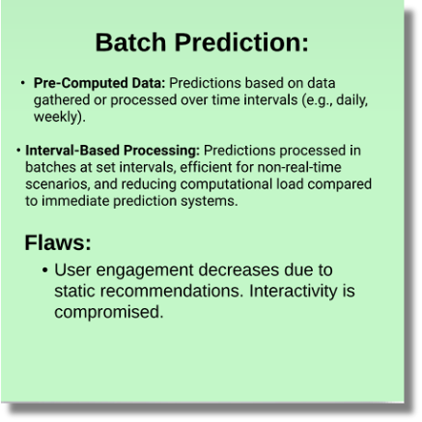
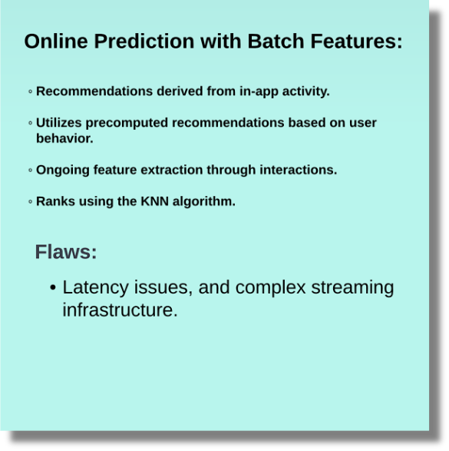
WHAT ARE THE EXISTING SOLUTIONS

Slide 10
DATASET
We are using the existing data of products for the solution of coldstart problem from other platforms.
We are using a dataset related to over 2 Million customer reviews and ratings of beauty-related products sold on their website. It contains the unique UserId (Customer Identification), the product ASIN (Amazon's unique product identification code for each product), Ratings (ranging from 1-5 based on customer satisfaction), and the Timestamp of the rating (in UNIX time)
This dataset includes reviews (ratings, text, helpfulness votes), product metadata (descriptions, category information, price, brand, and image features), and links (also viewed/also bought graphs).
By the time progresses through the clickstream data we are going to construct our own database.
That Realtime generated data of adding to cart, viewing item, purchasing, reviewing will be added into the database.

Slide 11
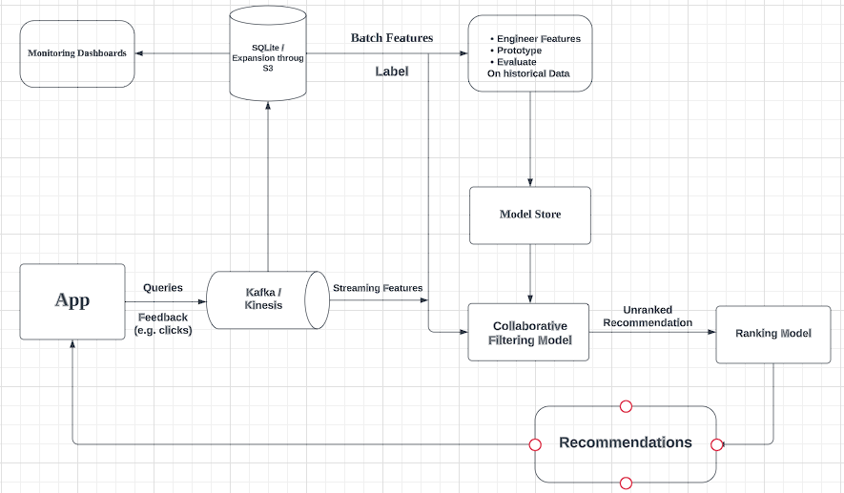
Proposed Methodology:

Slide 12
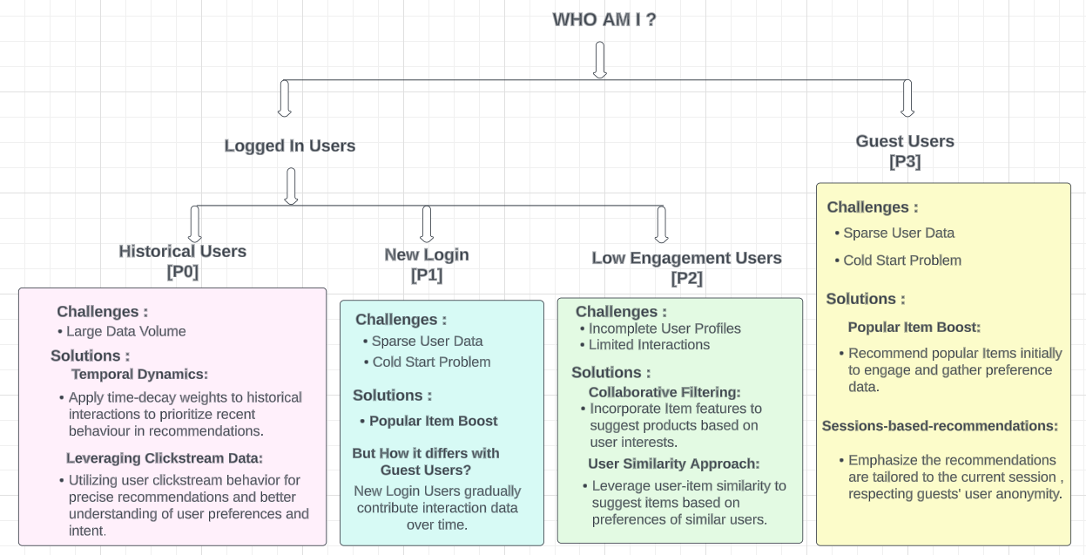
USE CASES
Notes:
Challenge: Tailoring recommendations without user profiles.
Tailor product suggestions in real time based on guest users' ongoing interactions.
Applying collaborative filtering techniques to analyze the behavior of similar guest users.
Start collecting data as soon as a guest user enters the platform.
Recommendations evolve as guest users interact further.
Capture relevant actions such as product views, clicks, time spent on pages, and interactions.
Interactions are stored only for the session's duration.
Use a Collaborative Filtering to present a curated list of popular and trending products list.
New Login Users:
Challenges:
Sparse User Data: Limited historical data for accurate recommendations.
Cold Start Problem: Lack of user behavior patterns in the system.
Solutions:
Popular Item Boost: Recommend popular items initially to engage users and gather preference data.
Historical Users:
Challenges:
Data Volume: Large amount of historical data leading to potential noise.
Solutions:
Temporal Dynamics:
Apply time-decay weights to historical interactions to prioritize recent behavior in recommendations.
Feature Weighting:
Adjust the influence of historical data based on item attributes and user preferences.
Leveraging Clickstream Data:
Utilizing user clickstream behavior for precise recommendations and better understanding of user preferences and intent.
Low Engagement Users:
Challenges:
Limited Interaction: Sparse or infrequent user actions to base recommendations on.
Incomplete User Profiles: Insufficient data for accurate understanding.
Solutions:
Neighborhood Models: Leverage user-item similarity to suggest items based on preferences of similar users.
Collaborative Filtering: Incorporate item features to suggest products based on user interests.
Realtime Clickstream also...

Slide 13
RESULT
CLICK-THROUGH RATE:
CTR = (NUMBER OF CLICKED ITEMS) / (TOTAL NUMBER OF RECOMMENDED ITEMS)
PERCENTAGE OF CLICKS ON RECOMMENDATIONS. MEASURES RECOMMENDATION EFFECTIVENESS.
CTR STANDS AT 1.18, IMPLYING ABOUT 1.18 CLICKS PER 100 RECOMMENDATIONS. IT GAUGES ENGAGEMENT; INDUSTRY BENCHMARKS CONTEXTUALIZE PERFORMANCE.
DIVERSITY SCORE:
THE COSINE SIMILARITY BETWEEN THE VECTORS REPRESENTING THE CLICKED ITEMS' ATTRIBUTES OR EMBEDDINGS. WITH A DIVERSITY SCORE OF 0.23, CLICKED ITEMS SHOW REASONABLE ATTRIBUTE AND EMBEDDING DIVERSITY. HOWEVER, ASSESSING QUALITY REQUIRES CONTEXT ON TYPICAL DIVERSITY SCORE RANGES IN THE DATASET.
PERSONALIZED CLICK-THROUGH DIVERSITY INDEX (PCDI):
PCDI = (CTR * WEIGHT OF CTR) + (DIVERSITY SCORE * WEIGHT OF DIVERSITY)
PCDI AT 1.08 COMBINES CTR AND DIVERSITY SCORE, REFLECTING SYSTEM EFFECTIVENESS IN DIVERSE, ENGAGING SUGGESTIONS. WEIGHT ALLOCATION INSIGHT IS CRUCIAL FOR ACCURATE INTERPRETATION.
MODEL PERFORMANCE:
PCDI COMBINES CTR AND DIVERSITY SCORE USING WEIGHTS.
Balanced PCDI suggests a good mix of engagement and diversity.
PCDI > 1 indicates favorable performance.

Slide 14

CONCLUSION
FUTURE SCOPE
Algorithm Selection: After reviewing various filtering techniques and recommender system algorithms, we have chosen collaborative filtering due to its widespread use and effectiveness.
Data Collection Technology: We have identified Apache Kafka as the technology of choice for gathering clickstream data, ensuring real-time data ingestion and robust data processing capabilities.
Strategic Decision: The combination of collaborative filtering and Apache Kafka positions us to build a robust recommendation system that leverages user behavior data efficiently, enhancing our ability to provide personalized recommendations.
BANDIT FOR MODEL EVALUATION:
Implementing bandit algorithms for enhanced model evaluation and experimentation.
HYBRID RECOMMENDER ALGORITHM:
Integrating content-based methods with collaborative filtering for enhanced recommendation quality and personalization.
MLOPS INTEGRATION:
Deploy and manage the system across diverse e-commerce applications using MLOps practices.

Slide 15
GLOSSARY
FEEDBACK LOOP: SYSTEM REINFORCING SIMILAR ITEMS BASED ON PAST INTERACTIONS. MAY LIMIT VARIETY.
K-NEAREST NEIGHBORS (KNN): A CLASSIFICATION ALGORITHM THAT FINDS SIMILAR USERS OR ITEMS. RECOMMENDS BASED ON HISTORICAL INTERACTIONS.
MATRIX FACTORIZATION: DECOMPOSES USER-ITEM INTERACTION MATRICES INTO LATENT FACTORS, REVEALING HIDDEN PATTERNS IN RECOMMENDER SYSTEMS.
PERSONALIZATION: ADAPTING RECOMMENDATIONS BASED ON USER PREFERENCES AND ACTIONS.
PERSONALIZED CLICK-THROUGH DIVERSITY INDEX (PCDI): METRIC COMBINING ENGAGEMENT AND DIVERSITY TO EVALUATE RECOMMENDATIONS HOLISTICALLY.
RANKING MODEL: ASSIGNS PRIORITY TO ITEMS BASED ON FACTORS LIKE ENGAGEMENT. OPTIMIZES RECOMMENDATION ORDER.
RECOMMENDER SYSTEM: SOFTWARE SUGGESTING ITEMS BASED ON USER PREFERENCES. ENHANCES USER EXPERIENCE AND ENGAGEMENT.
SINGULAR VALUE DECOMPOSITION (SVD): FACTORIZES MATRICES INTO LATENT FACTORS, OFTEN USED FOR COLLABORATIVE FILTERING TO REVEAL USER-ITEM RELATIONSHIPS.
APACHE KAFKA: DISTRIBUTED EVENT STREAMING PLATFORM FOR REAL-TIME DATA PROCESSING. CAPTURES INTERACTIONS FOR DYNAMIC RECOMMENDATIONS.
CLICK-THROUGH RATE (CTR): PERCENTAGE OF CLICKS ON RECOMMENDATIONS. MEASURES RECOMMENDATION EFFECTIVENESS.
CLICKSTREAM DATA: USER INTERACTIONS DATA—CLICKS, VIEWS, SEARCHES, PURCHASES. CAPTURES BEHAVIOR FOR INSIGHTS.
COLD START: CHALLENGE WHEN NEW USERS/ITEMS HAVE LIMITED HISTORY. ADDRESSED WITH TAILORED STRATEGIES.
Collaborative Filtering (CF): Predicts user preferences based on similar users' behaviors. It personalizes recommendations by identifying interaction patterns.
DIVERSITY SCORE: QUANTIFIES RECOMMENDATION VARIETY, CONSIDERING DIFFERENCES BETWEEN ITEMS.

Slide 16
REFERENCES
DPENG, Y. (2020). A SURVEY ON MODERN RECOMMENDATION SYSTEM BASED ON BIG DATA. [PREPRINT]. DEPARTMENT OF ELECTRICAL AND COMPUTER ENGINEERING, UNIVERSITY OF MIAMI. EMAIL: YXP412@MIAMI.EDU.
ALAMDARI, P. M., NAVIMIPOUR, N. J., HOSSEINZADEH, M., SAFAEI, A. A., & DARWESH, A. (2020). A SYSTEMATIC STUDY ON THE RECOMMENDER SYSTEMS IN THE E-COMMERCE. IEEE ACCESS, 1–1. DOI:10.1109/ACCESS.2020.3002803
PAL, G., ATKINSON, K. & LI, G. REAL-TIME USER CLICKSTREAM BEHAVIOR ANALYSIS BASED ON APACHE STORM STREAMING. ELECTRON COMMER RES 23, 1829–1859 (2023). HTTPS://DOI.ORG/10.1007/S10660-021-09518-4
RAKSHIT, P., SAHA, S., CHATTERJEE, A., MISTRI, S., DAS, S., DHAR, G. (2023). A POPULARITY-BASED RECOMMENDATION SYSTEM USING MACHINE LEARNING. IN: DEVA SARMA, H.K., PIURI, V., PUJARI, A.K. (EDS) MACHINE LEARNING IN INFORMATION AND COMMUNICATION TECHNOLOGY . LECTURE NOTES IN NETWORKS AND SYSTEMS, VOL 498. SPRINGER, SINGAPORE. HTTPS://DOI.ORG/10.1007/978-981-19-5090-2_14
ACILAR, AM. AND A ARSLAN, A COLLABORATIVE FILTERING METHOD BASED ON ARTIFICIAL IMRNUNE NETWORK. EXPERT SYSTEMS WITH APPLICATIONS, 2020. 36(4): P. 8324-8332.
D. ALGAWIAZ, G. DOBBIE AND S. ALAM, "PREDICTING A USER’S PURCHASE INTENTION USING ADABOOST," 2019 IEEE 14TH INTERNATIONAL CONFERENCE ON INTELLIGENT SYSTEMS AND KNOWLEDGE ENGINEERING (ISKE), DALIAN, CHINA, 2021, PP. 324-328, DOI: 10.1109/ISKE47853.2019.9170316.
LIU, Q. , ET AI. , ENHANCING COLLABORATIVE FILTERING BY USER INTEREST EXPANSION VIA PERSONALIZED RANKING. IEEE TRANSACTIONS ON SYSTEMS, MAN, AND CYBERNETICS, PART B (CYBERNETICS), 2021. 42(1): P. 218-233..
DE CAMPOS, L.M. , ET AI. , COMBINING CONTENT-BASED AND COLLABORATIVE RECOMMENDATIONS: A HYBRID APPROACH BASED ON BAYESIAN NETWORKS. INTERNATIONAL JOURNAL OF APPROXIMATE REASONING, 2010. 51(7): P. 785- 799.
MANOTUMRUKSA, J., & YILMAZ, E. (2020). SEQUENTIAL-BASED ADVERSARIAL OPTIMISATION FOR PERSONALISED TOP-N ITEM RECOMMENDATION. PROCEEDINGS OF THE 43RD INTERNATIONAL ACM SIGIR CONFERENCE ON RESEARCH AND DEVELOPMENT IN INFORMATION RETRIEVAL. DOI:10.1145/3397271.3401264

